Slide 1
Project Tele Customer CHURN
Professor- Dr. Waleed Youssef
University of Maryland Baltimore county
Samhita Chamathota

Slide 2
PROJECT AND PROBLEM DEFINITION
Project Description: Customer attrition (dropping out of connection) is one of the most important metrics for telecom industry. It costs more for a company to acquire new customer than to retain old customers. Hence this project will base on finding customers who are likely to churn and understand causes of churn.
Project objective:
-To predict customer churn
-Highlighting the main variables and correlations influencing customer churn.
-Use various ML algorithms to build prediction models, evaluate the accuracy and performance of these models. Utilize various applications like Python, Mongodb and spark in the process.
- Find out best model and provide executive summary through proper visualizations.
Input data: Telco customer dataset (Data.gov) [7043 rows and 21 features]
Expected outcome: Predict customers dropping out.

Slide 3
PROJECT RELATION AND WORK
Big data relation : Collected Telco Customer Churn dataset containing 7043 rows and 21 columns. It manually difficult to analyze all the unstructured columns and complex features in the data, we are using big data to understand customer behavior and predict the decisions data. On the other hand, this is only a subset of real-time data. In real-time, the amount of data will be very large and will be going on added periodically.
Project work :
Loading data/defining schema
Exploring /Visualizing the data set
Performing necessary transformations
Feature engineering
Model creation, training and evaluation
Model results and Visualization

Slide 4
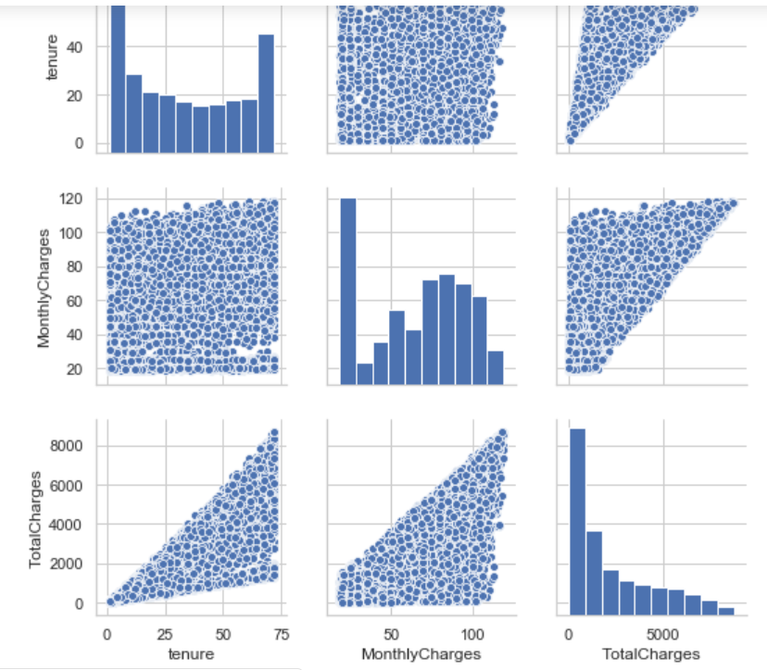
Data Exploration
Total charges, Monthly charges and Tenure found to be the important features in the dataset.

Slide 5
Model results
Models | Train Accuracy | Test Accuracy
Logistic Regression | 0.85 | 0.82
Decision Tree Classifier | 0.85 | 0.82
Random Forest | 0.80 | 0.85
Gradient Boost Classifier | 0.87 | 0.81
Feature selection inside the algorithm was found better in Random forest and hence continued to write code in determining the roc curve to illustrate the predictive analysis.

Slide 6
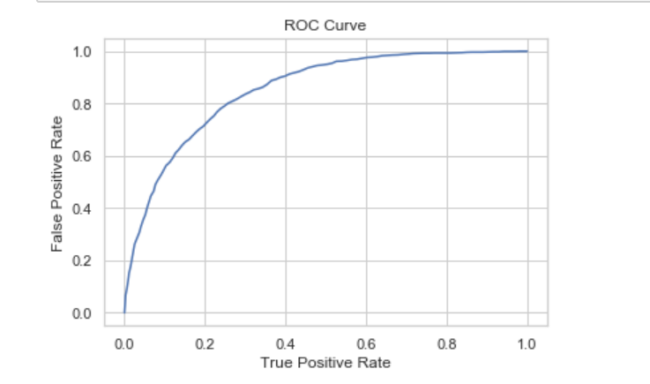
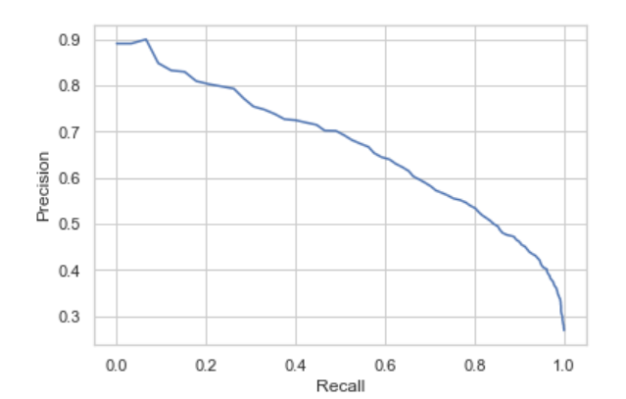
Graphical representation of Models accuracy
Logistic Regression Roc curve
We used Roc curve theory to analyze the accuracy and decide best model for our dataset.
Classifiers that give curves closer to the top-left corner indicate a better performance.
Random forest Roc curve seems fine the accuracy of 82 percent. Although further comparison can be made.

Slide 7
Conclusion
Project –
Best model found to be the Random forest on Telco customer churn dataset.
Companies can use this model to make the predictions on customer dropping out.
With this prediction they can retain their customer.
Also, they can improve their approach based on the feature importance shared in this model.

